Slide 1
IBM APPLIED DATA SCIENCE CAPSTONE
IBRAHEEM KEKERE-EKUN
11TH FEBRUARY, 2021

Slide 2
DATA
London borough and neighbourhood data from Wikipedia.org
London crime rate data from finder.com
London housing price data from property.co.uk
London neighbourhood coordinates from Geocoder library
London borough coordinates from github
London venue data from foursquare.com

Slide 3
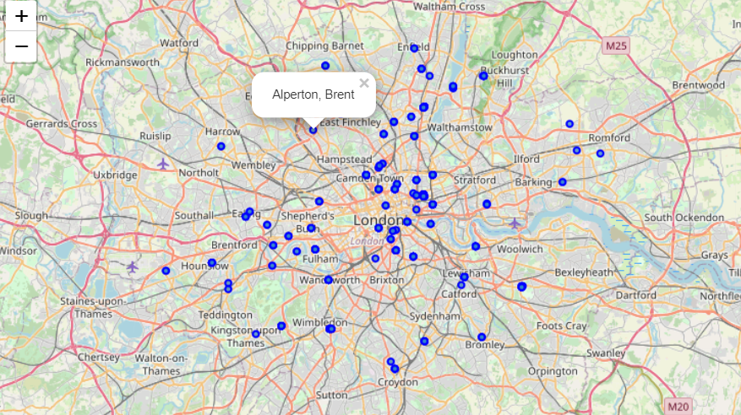
London neighbourhoods
Each marker represents a neighbourhood.

Slide 4
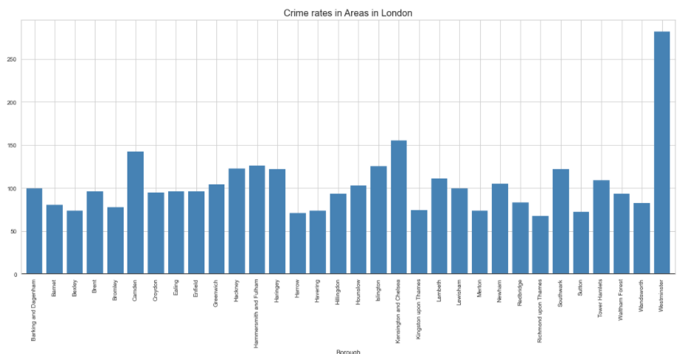
London crime rates
It appears that Westminster has the highest crime rates per 1000 people

Slide 5
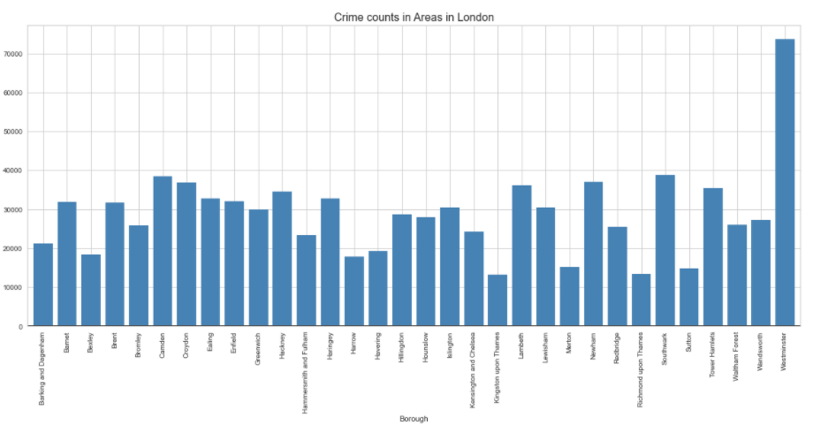
London crime counts in 2020
Westminster also has the highest crime counts

Slide 6
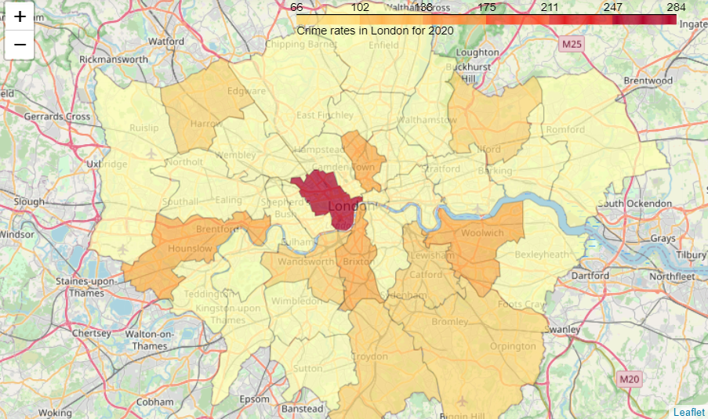
Crime rates on map of London

Slide 7
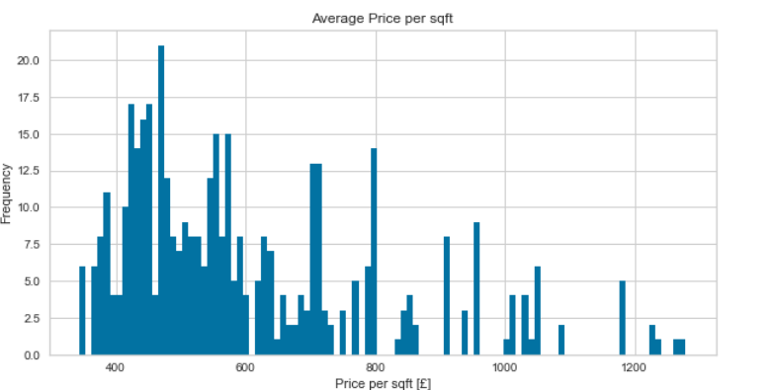
Average price per sqft in £
Many areas in London have the price per sqft between 350 and 800

Slide 8
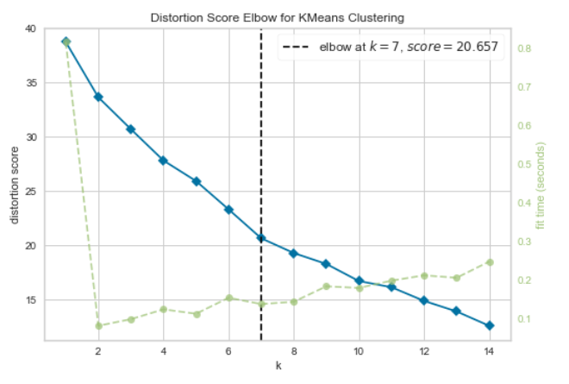
MODEL: K Means
The ideal number of clusters is 7 as predicted by the KElbowvisualizer model

Slide 9
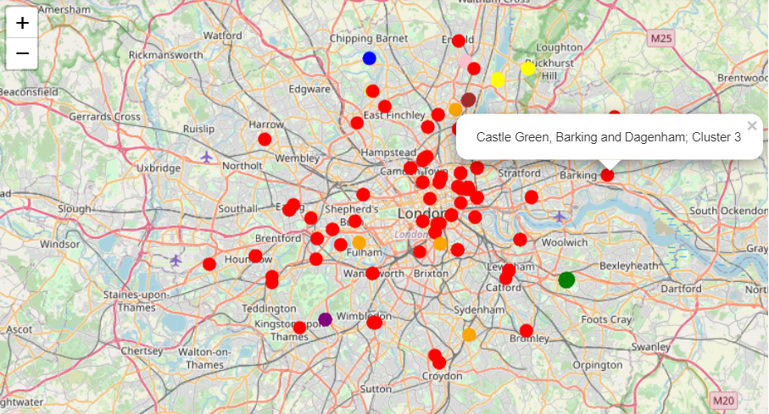
RESULTS Clusters
Each color marker represents a cluster

Slide 10
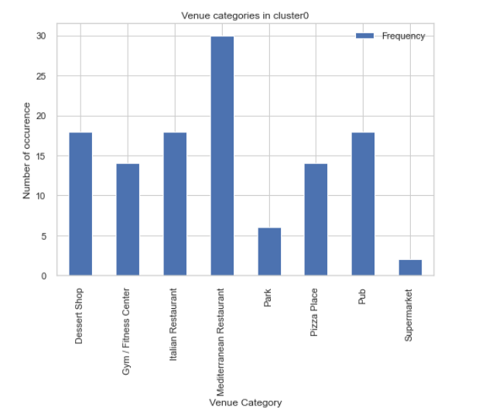
Cluster0
BEXLEY
['Barnehurst', 'Barnes Cray', 'Belvedere', 'Bexley (also Old Bexley, Bexley Village)', 'Blackfen', 'Colyers', 'Crayford', 'Crook Log', 'East Wickham', 'Foots Cray', 'Lamorbey', 'Lessness Heath', 'North Cray', 'North End', 'Northumberland Heath', 'Slade Green', 'Upton', 'Welling']
Mediterrainian restaurants, pubs, Italian restaurants and dessert shops are common here

Slide 11
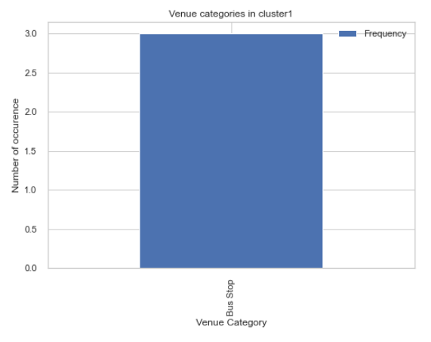
Cluster1
BARNET
['Childs Hill', 'East Finchley', 'Hampstead Garden Suburb']
Bus stops are common in cluster2

Slide 12
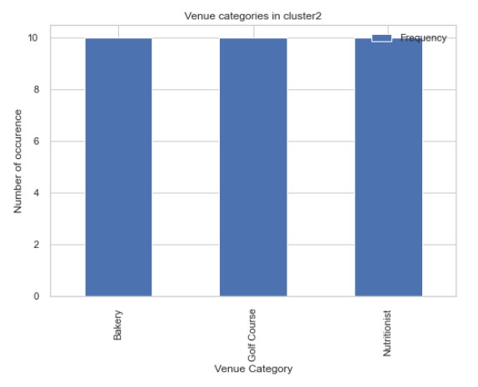
Cluster2
NEWHAM
['Canning Town', 'Custom House', 'East Ham', 'Forest Gate', 'Little Ilford', 'Manor Park', 'Maryland', 'North Woolwich', 'Silvertown', 'Stratford']
Nutritionists, golf courses and bakeries are common in this cluster

Slide 13
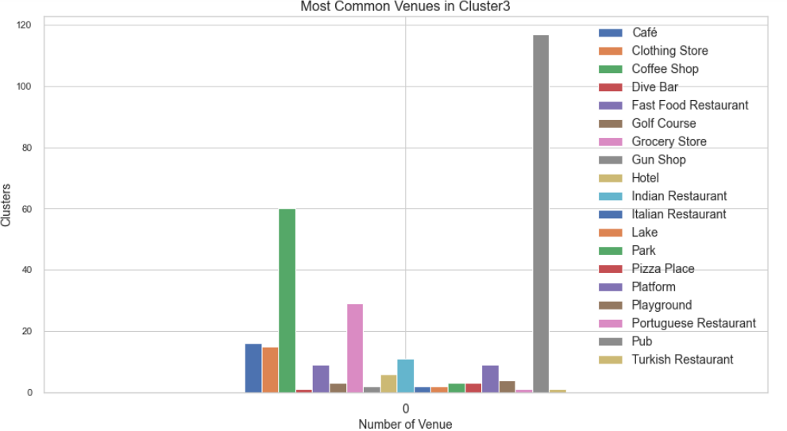
Cluster3
['Croydon', 'Bexley', 'Redbridge', 'Westminster', 'Brent', 'Bromley', 'Islington', 'Havering', 'Barnet', 'Enfield', 'Wandsworth', 'Southwark', 'Barking and Dagenham', 'Richmond upon Thames', 'Newham', 'Sutton', 'Ealing', 'Lewisham', 'Harrow', 'Camden', 'Kingston upon Thames', 'Tower Hamlets', 'Greenwich', 'Haringey', 'Hounslow', 'Lambeth', 'Kensington and Chelsea', 'Merton', 'Hackney']
Pubs, coffee shops and grocery stores areamong the top venue categories. It isn’t possible to show all the neighbourhoods in this cluster because they are too many.

Slide 14
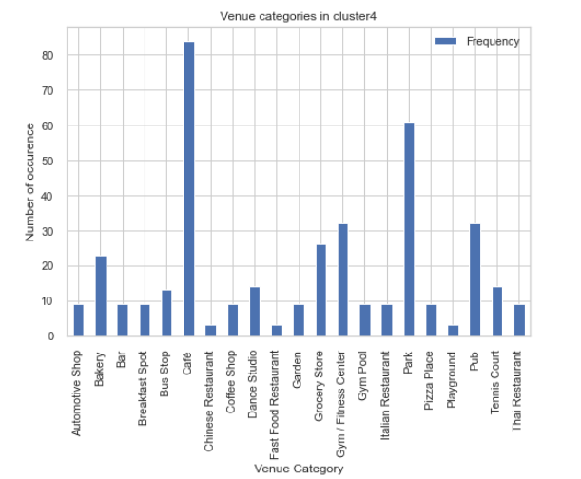
Cluster4
CROYDON
['Coulsdon', 'Kenley', 'Old Coulsdon', 'Purley', 'Riddlesdown', 'Sanderstead', 'Selhurst', 'Selsdon', 'South Croydon', 'South Norwood', 'Upper Norwood']
HAMMERSMITH AND FULHAM
['Fulham', 'Hammersmith', 'Old Oak Common', 'Parsons Green', 'Sands End', "Shepherd's Bush", 'West Kensington', 'White City', 'Wormwood Scrubs']
HILLINGDON
['Cowley', 'Harefield', 'Harlington', 'Harmondsworth', 'Ickenham', 'Longford', 'Northwood', 'Ruislip', 'Sipson', 'South Ruislip', 'Uxbridge', 'West Drayton', 'Yeading', 'Yiewsley']
Cafes, parks, pubs and grocery stores are common in this cluster

Slide 15
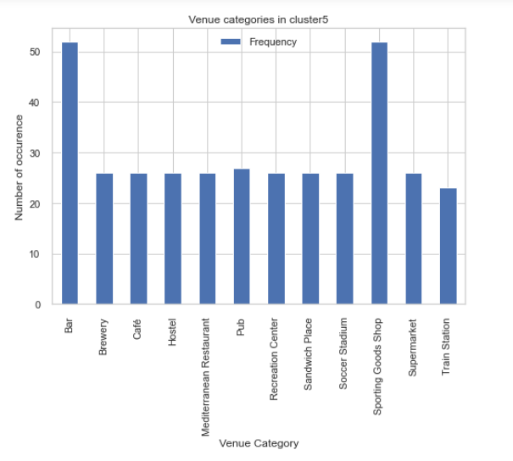
Cluster5
BROMLEY
['Anerley', 'Aperfield', 'Bickley', 'Biggin Hill', 'Bromley Common', 'Chelsfield', 'Chislehurst', 'Cudham', 'Derry Downs', 'Downe', 'Eden Park', 'Elmers End', 'Elmstead', 'Goddington', 'Hayes', 'Hazelwood', 'Keston', 'Leaves Green', 'Locksbottom', 'Mottingham', 'Penge', 'Petts Wood', "Pratt's Bottom", 'Southborough', 'St Mary Cray', "St Paul's Cray"]
Sporting goods shops and bars are common in this cluster

Slide 16
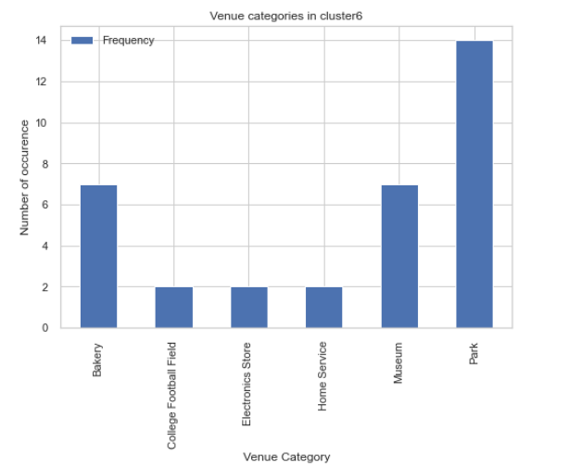
Cluster6
HARROW
['Harrow Weald', 'Hatch End', 'Pinner', 'Rayners Lane', 'South Harrow', 'Wealdstone', 'West Harrow']
Parks, bakeries and museums are common in this cluster

Slide 17
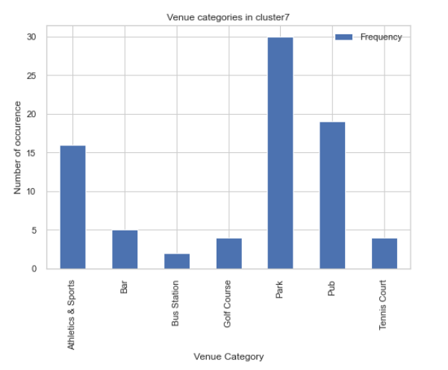
Cluster7
BRENT
['Kingsbury', 'Preston', 'Tokyngton', 'Wembley Park']
WALTHAM FOREST
['Cann Hall', 'Chingford', 'Highams Park', 'Leytonstone', 'Upper Walthamstow', 'Walthamstow', 'Walthamstow Village']
WESTMINSTER
['Aldwych', 'Bayswater', 'Charing Cross', 'Chinatown', 'Covent Garden', 'Lisson Grove', 'Maida Vale', 'Marylebone (also St Marylebone)', 'Mayfair', 'Paddington', 'Soho', "St John's Wood“]
Parks, pubs and athletics and sports are common in this cluster

Slide 18
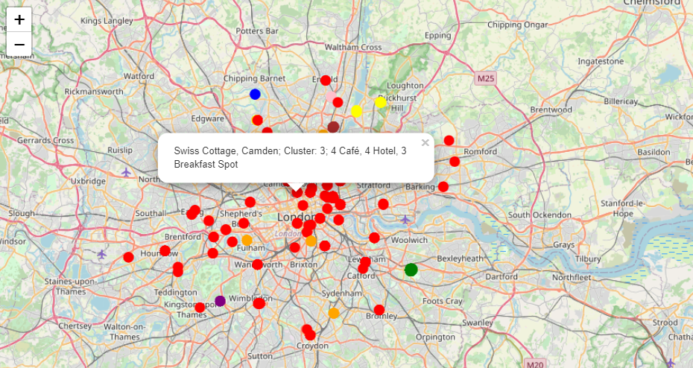
The number of top three venues
Each marker shows the number of top three venues for that neighbourhood

Slide 19
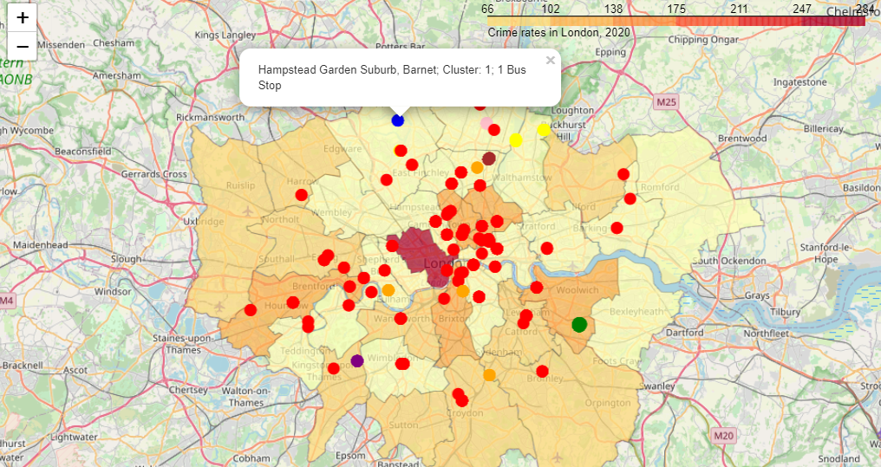
Crime rates
Crime rate choropleth map with clusters superimposed on it

Slide 20
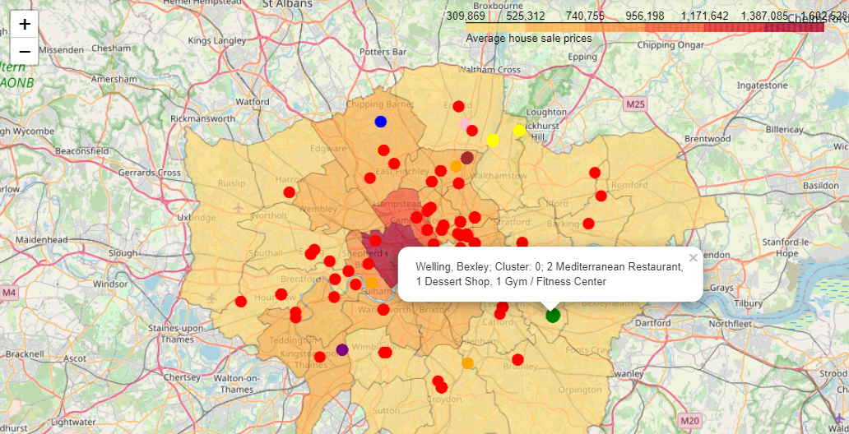
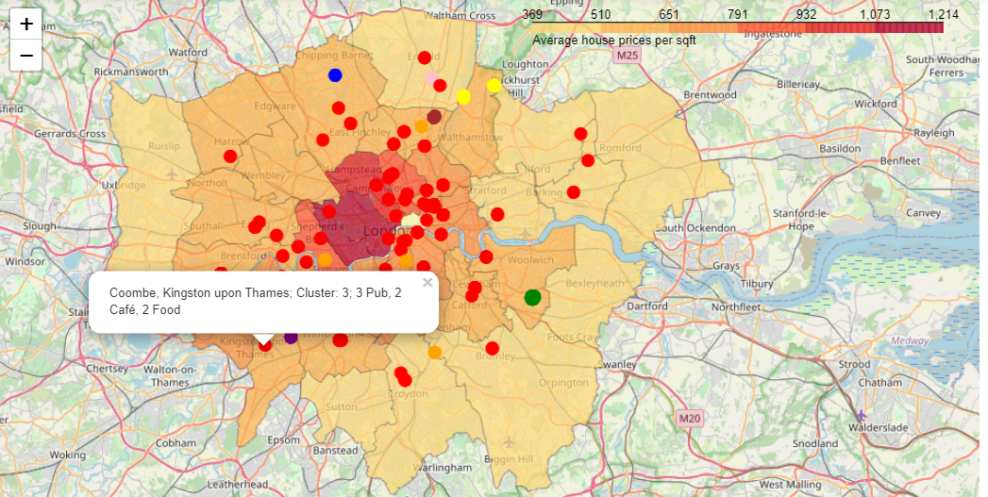
Choropleth maps showing the average house sale price and average house price per sqft in £ for each London borough
The more expensive houses are in the middle of London

Slide 21
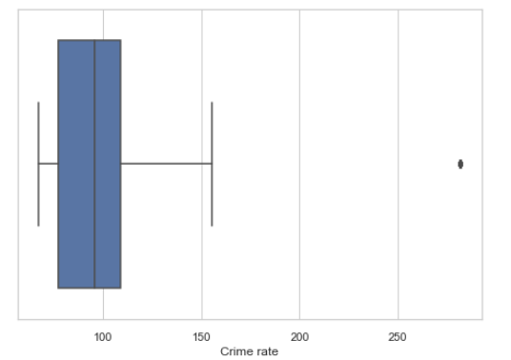
The median crime rate is 96.1
Barnet, Bexley, Bromley, Croydon, Ealing, Enfield, Harrow, Havering, Hillingdon, Kingston upon Thames, Merton, Redbridge, Richmond upon Thames, Sutton, Waltham Forest and Wandsworth'
have crime rates below the median crime rate of 96.1.
Westminster is an outlier with a crime rate of 281.7

Slide 22
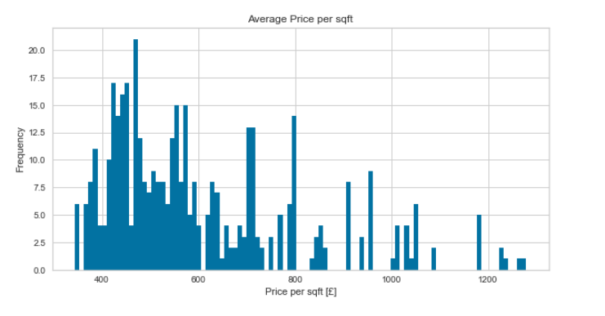
Averahe house price per sqft
Croydon, Bexley, Redbridge, Westminster, Brent, Bromley, Islington, Havering, Barnet, Enfield, Wandsworth, Southwark, Barking and Dagenham, Richmond upon Thames, Newham, Sutton, Ealing, Lewisham, Harrow, Camden, Kingston upon Thames, Tower Hamlets, Greenwich, Haringey, Hounslow, Waltham Forest, Kensington and Chelsea, Merton, Hillingdon, Hackney and Hammersmith and Fulham have the average housing price per sqft in the low range.

Slide 23
Boroughs with low average price per sqft and below the median crime rate
Barnet, Bexley, Bromley, Croydon, Ealing, Enfield, Harrow, Havering, Hillingdon, Kingston upon Thames, Merton Redbridge, Richmond upon Thames, Sutton, Waltham Forest and Wandsworth.

Slide 24
Conclusion
Clustered London neighbourhoods based on venue categories
Analysed each cluster and found the most common venue categories and their counts
Retrieved the boroughs with low average house sale price and crime rates
The results of this project can be a good place to start for anyone that wants to move to London.

